Slide 1
Atliq Hardware Ad-Hoc Insights

Slide 2
Report 1: Croma India product wise sales for fiscal year 2021
As a product owner, generate a report of individual product sales for Croma India customer for FY – 2021.
The report should have following fields:
Month
Product name
Variant
Sold quantity
Gross Price Per Item
Gross Price Total

Slide 3
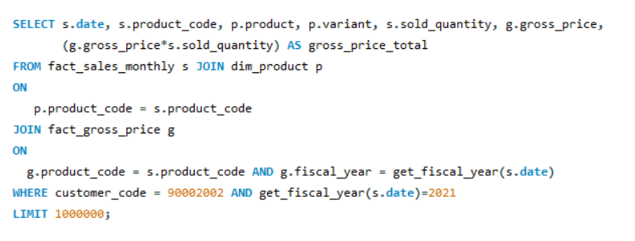
Report 1:

Slide 4
Report 2: Gross Monthly total sales report for Croma
As a product owner, generate a aggregate monthly gross sales report for Croma India customer so that I can track how much sales this particular customer is generating for Atliq and manage our relationship accordingly.
The report should have following fields,
Month
Total gross sales to Croma India in this month

Slide 5
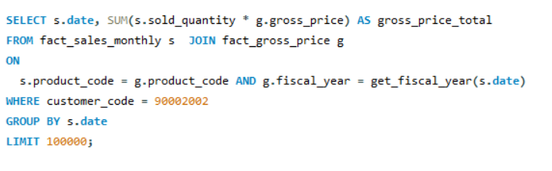
Report 2:

Slide 6
Report 3: Stored Procedure for market badge
Create a stored procedure that can determine the market badge based on following logic:
If total sold quantity > 5 million then market is considered Gold else it is Silver
My input will be
Market
Fiscal Year
Output
Market badge

Slide 7
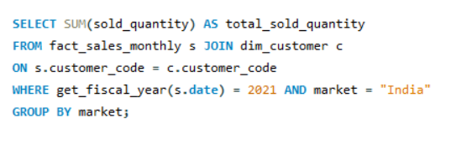
Report 3:
Step-1: Generate monthly gross sales report for Croma India for all the years

Slide 8
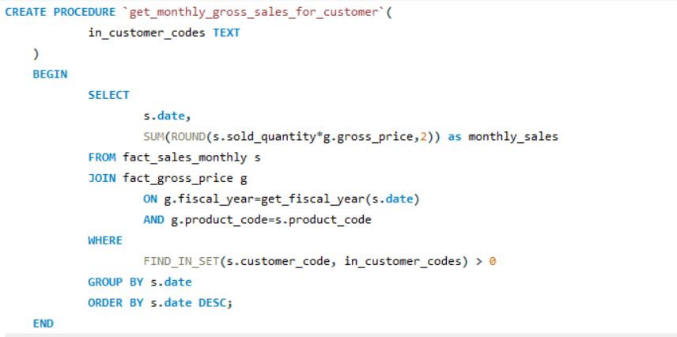
Report 3:
Step-2: Creating stored procedure for the above report for all customers

Slide 9
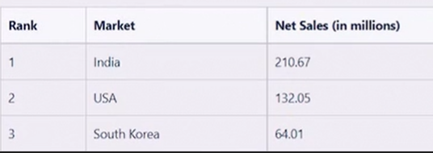
Report 4: Top markets for a given fiscal year
As a product owner I want a report for top markets by net sales for given fiscal year so that I can have a holistic view of our financial performance.
We will probably write stored procedure for this as we will need this report going forward.
Report for top markets

Slide 10
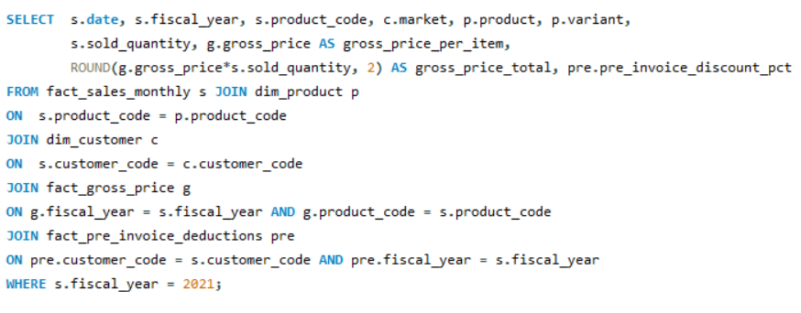
Report 4:
Step-1: Get the net invoice sales amount using the CTE's

Slide 11
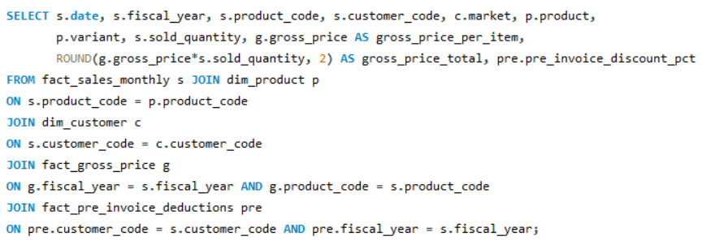
Report 4:
Step-2: Creating the view `sales preinv discount`

Slide 12
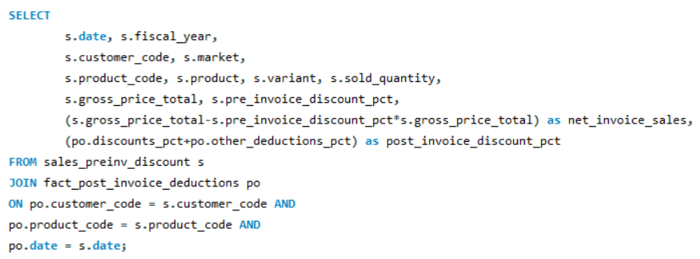
Report 4:
Step-3: Now generate ‘net invoice sales' and 'post invoice discount pct' using the above created view "sales preinv discount"`

Slide 13
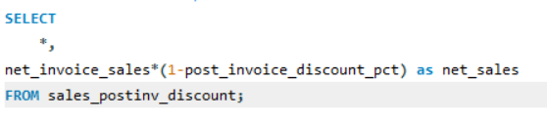
Report 4:
Step-4: Create a report for net sales

Slide 14
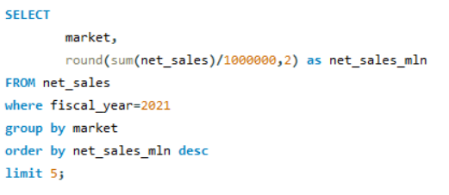
Report 4:
Step-5: Get top 5 market by net sales in fiscal year 2021

Slide 15
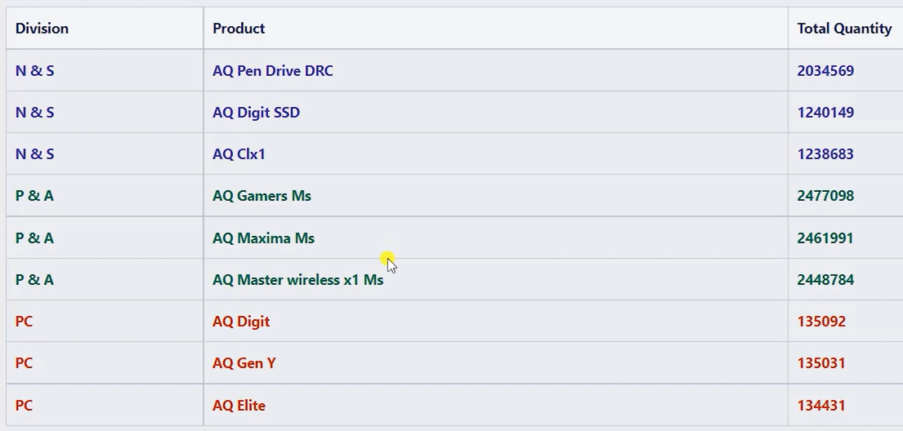
Report 5: Get top n products in each division by their quantity sold
Write a stored procedure for getting top n products in each division by their quantity sold in a given fiscal year. For example below would be the result for FY = 2021

Slide 16
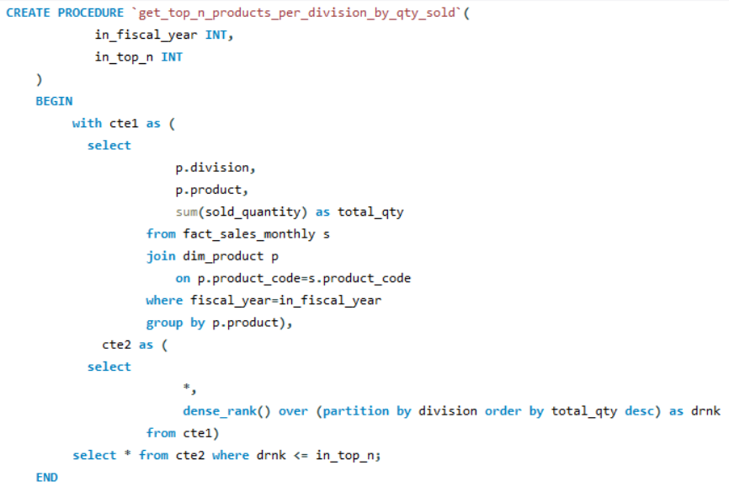
Report 5:

Slide 17
Report 6: Forecast Accuracy for all customers for a given fiscal year
As a product owner, I need an aggregate forecast accuracy report for all customers for a given fiscal year so that I can track the accuracy of the forecast we make for these customers.
The report should have the following fields,
Customer code, name, market
Total sold quantity
Total Forecast Quantity
Net Error
Absolute Error
Forecast Accuracy %

Slide 18
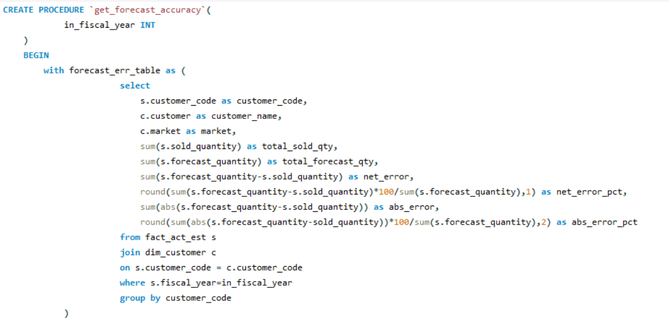
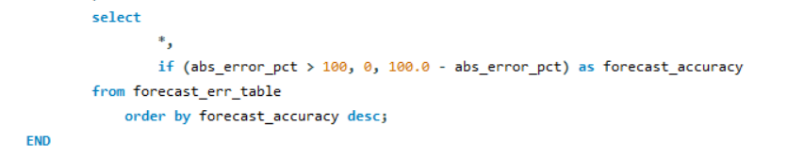
Report 6:

Slide 19
THANK YOU

